Slide 1
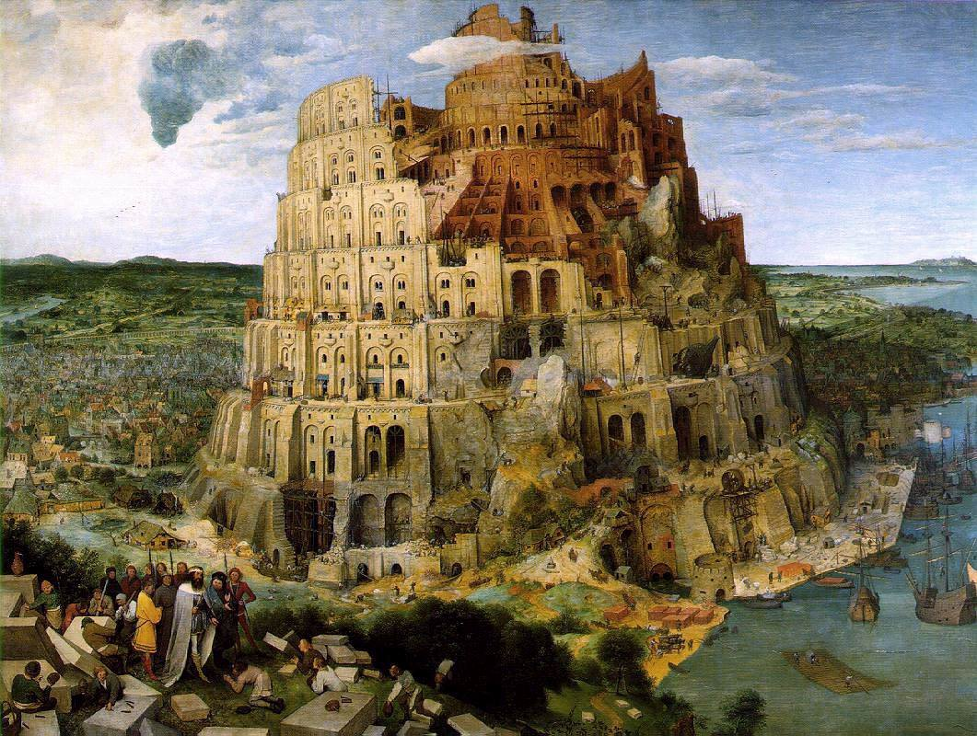
Machine Translation: Challenges and Approaches
Based on a talk by Nizar Habash http://www.nizarhabash.com/
Professor of Computer Science,
New York University Abu Dhabi

Slide 2

Google offers translations between many languages: Afrikaans Albanian Amharic history Arabic Armenian Azerbaijani Basque Belarusian Bengali Bosnian Bulgarian Catalan Cebuano Chichewa Chinese Corsican Croatian Czech Danish history Dutch check English Esperanto Estonian Filipino Finnish history French Frisian Galician Georgian history German Greek Gujarati Haitian Creole Hausa Hawaiian Hebrew Hindi Hmong Hungarian Icelandic Igbo Indonesian Irish Italian Japanese Javanese Kannada Kazakh Khmer Kinyarwanda Korean Kurdish (Kurmanji) Kyrgyz Lao Latin Latvian Lithuanian Luxembourgish Macedonian Malagasy Malay Malayalam Maltese Maori Marathi Mongolian Myanmar (Burmese) Nepali Norwegian Odia (Oriya) Pashto Persian Polish Portuguese Punjabi Romanian Russian Samoan Scots Gaelic Serbian Sesotho Shona Sindhi Sinhala Slovak Slovenian Somali Spanish Sundanese Swahili Swedish Tajik Tamil Tatar Telugu Thai Turkish Turkmen Ukrainian Urdu Uyghur Uzbek Vietnamese Welsh Xhosa Yiddish Yoruba Zulu

Slide 3
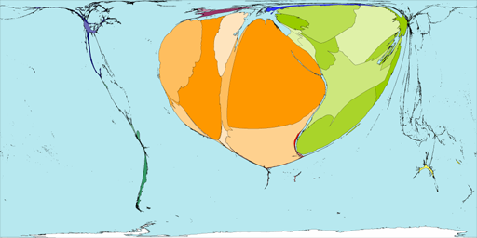
WorldMapper The world as you’ve never seen it before
List of languages with maps showing world-wide distribution:
http://www.worldmapper.org/extraindex/text_language.html
Eg Arabic:

Slide 4
Road Map
Multilingual Challenges for MT
MT Approaches
MT Evaluation
Notes:
My work on palestinian, arabic mt and arabic hebrew mt
Highlight similarities and differences
A lot of similarities/differences not included

Slide 5
Multilingual Challenges
Complex Orthography (writing system)
Ambiguous spelling, eg Arabic vowels omitted
كتب الاولاد اشعارا كَتَبَ الأوْلادُ اشعَاراً
Ambiguous word boundaries, eg Chinese
Lexical Ambiguity
Bank ➔ بنك (financial) vs. ضفة(river)
Eat ➔ essen (human) vs. fressen (animal)
Notes:
My work on palestinian, arabic mt and arabic hebrew mt
Highlight similarities and differences
A lot of similarities/differences not included

Slide 6
Multilingual Challenges Morphological complexity and variation
Affixation vs. Root+Pattern
write | ➔ | written | كتب | ➔ | مكتوب
kill | ➔ | killed | قتل | ➔ | مقتول
do | ➔ | done | فعل | ➔ | مفعول
Tokenization: a “word” can be a whole phrase
conj
And the cars | ➔ | and the cars
والسيارات | ➔ | w Al SyArAt
Et les voitures | ➔ | et les voitures
noun
article
plural

Slide 7
Translation Divergences
conflation
لست
am
suis
هنا
I
not
here
Je
ne
pas
ici
لست هنا
I-am-not here
I am not here
Je ne suis pas ici
I not am not here

Slide 8
Translation Divergences head swap and categorial
English | John swam across the river quickly
Spanish | Juan cruzó rapidamente el río nadando Gloss: John crossed fast the river swimming
Arabic | اسرع جون عبور النهر سباحة Gloss: sped john crossing the-river swimming
Chinese | 约翰 快速 地 游 过 这 条 河 Gloss: John quickly (DE) swam cross the (Quantifier) river
Russian | Джон быстро переплыл реку Gloss: John quickly cross-swam river

Slide 9
Corpus resources for training
Need a Corpus (eg web-as-corpus: WebBootCat) and DICTIONARY, other NLP resources.
BUT: really need PARALLEL corpus, with
SOURCE and TARGET sentences ALIGNED.
Some languages have few resources, esp non-European languages: Bengali, Amharic, …

Slide 10
Road Map
Multilingual Challenges for MT
MT Approaches
MT Evaluation
Notes:
My work on palestinian, arabic mt and arabic hebrew mt
Highlight similarities and differences
A lot of similarities/differences not included

Slide 11
MT Approaches MT Pyramid
Source meaning
Target meaning
Source syntax
Target syntax
Source word
Gisting
Target word
Analysis
Generation
Notes:
Add line demarcation
I will be talking today about a new approach to MT that addresses the issue of resource asymmetry (or when resources on one side are less than other side)
The approach is called generation heavy MT..
The baisc intuition is…lang learning
Contributions of research include (in addition to approach (first bullet)
…tools.
System built
Eval of system
------
In MT , we talk about symmtry of resources…
(pyramid)
-> the level of depth (wrds syntx lex prag.etc)
→ divergences
->goals :roibustness (implementational, genre), correctness( accuracy, fluency, clarity, grammaticality), retargetability, reusability
->approaches – symbolic
-> lcs, systran
-> statistical approaches need it too(put waves…)
ibm models
->hybrids
-> halogen+
….ghmt : asymmetry
Why parse,

Slide 12
MT Approaches Gisting Example
Sobre la base de dichas experiencias se estableció en 1988 una metodología.
Envelope her basis out speak experiences them settle at 1988 one methodology.
On the basis of these experiences, a methodology was arrived at in 1988.

Slide 13
MT Approaches MT Pyramid
Source meaning
Target meaning
Source syntax
Transfer
Target syntax
Source word
Gisting
Target word
Analysis
Generation
Notes:
Add line demarcation
I will be talking today about a new approach to MT that addresses the issue of resource asymmetry (or when resources on one side are less than other side)
The approach is called generation heavy MT..
The baisc intuition is…lang learning
Contributions of research include (in addition to approach (first bullet)
…tools.
System built
Eval of system
------
In MT , we talk about symmtry of resources…
(pyramid)
-> the level of depth (wrds syntx lex prag.etc)
→ divergences
->goals :roibustness (implementational, genre), correctness( accuracy, fluency, clarity, grammaticality), retargetability, reusability
->approaches – symbolic
-> lcs, systran
-> statistical approaches need it too(put waves…)
ibm models
->hybrids
-> halogen+
….ghmt : asymmetry
Why parse,

Slide 14
MT Approaches Transfer Example
Transfer Lexicon
Map SL structure to TL structure
poner
butter
:subj
:mod
:obj
→
:subj
:obj
X
mantequilla
en
X
Y
:obj
Y
X puso mantequilla en Y
X buttered Y
Notes:
Go over each argument
Conflation Conditions
Existing Categorial Variation
Lexical Semantic Primitive Compatability
Thematic Consistency

Slide 15
MT Approaches MT Pyramid
Source meaning
Interlingua
Target meaning
Source syntax
Transfer
Target syntax
Source word
Gisting
Target word
Analysis
Generation
Notes:
Add line demarcation
I will be talking today about a new approach to MT that addresses the issue of resource asymmetry (or when resources on one side are less than other side)
The approach is called generation heavy MT..
The baisc intuition is…lang learning
Contributions of research include (in addition to approach (first bullet)
…tools.
System built
Eval of system
------
In MT , we talk about symmtry of resources…
(pyramid)
-> the level of depth (wrds syntx lex prag.etc)
→ divergences
->goals :roibustness (implementational, genre), correctness( accuracy, fluency, clarity, grammaticality), retargetability, reusability
->approaches – symbolic
-> lcs, systran
-> statistical approaches need it too(put waves…)
ibm models
->hybrids
-> halogen+
….ghmt : asymmetry
Why parse,

Slide 16
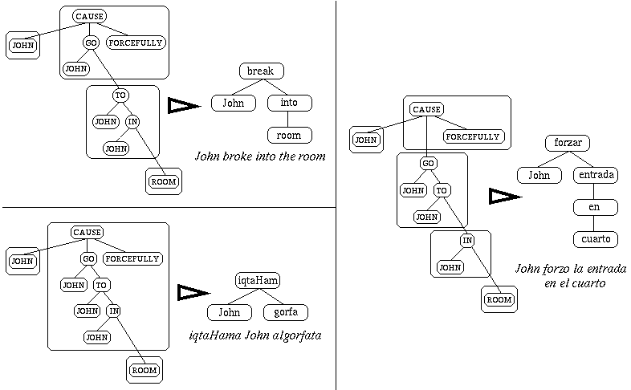
MT Approaches Interlingua Example: Lexical Conceptual Structure
(Dorr, 1993)

Slide 17
MT Approaches MT Pyramid
Source meaning
Interlingua
Target meaning
Source syntax
Transfer
Target syntax
Source word
Gisting
Target word
Analysis
Generation
Notes:
Add line demarcation
I will be talking today about a new approach to MT that addresses the issue of resource asymmetry (or when resources on one side are less than other side)
The approach is called generation heavy MT..
The baisc intuition is…lang learning
Contributions of research include (in addition to approach (first bullet)
…tools.
System built
Eval of system
------
In MT , we talk about symmtry of resources…
(pyramid)
-> the level of depth (wrds syntx lex prag.etc)
→ divergences
->goals :roibustness (implementational, genre), correctness( accuracy, fluency, clarity, grammaticality), retargetability, reusability
->approaches – symbolic
-> lcs, systran
-> statistical approaches need it too(put waves…)
ibm models
->hybrids
-> halogen+
….ghmt : asymmetry
Why parse,

Slide 18
MT Approaches MT Pyramid
Source meaning
Interlingual Lexicons
Target meaning
Source syntax
Transfer Lexicons
Target syntax
Source word
Dictionaries/Parallel Corpora
Target word
Analysis
Generation
Notes:
Add line demarcation
I will be talking today about a new approach to MT that addresses the issue of resource asymmetry (or when resources on one side are less than other side)
The approach is called generation heavy MT..
The baisc intuition is…lang learning
Contributions of research include (in addition to approach (first bullet)
…tools.
System built
Eval of system
------
In MT , we talk about symmtry of resources…
(pyramid)
-> the level of depth (wrds syntx lex prag.etc)
→ divergences
->goals :roibustness (implementational, genre), correctness( accuracy, fluency, clarity, grammaticality), retargetability, reusability
->approaches – symbolic
-> lcs, systran
-> statistical approaches need it too(put waves…)
ibm models
->hybrids
-> halogen+
….ghmt : asymmetry
Why parse,

Slide 19
Statistical MT Automatic Word Alignment
Slide based on Kevin Knight’s http://www.sims.berkeley.edu/courses/is290-2/f04/lectures/mt-lecture.ppt
GIZA++
A statistical machine translation toolkit used to train word alignments.
Uses Expectation-Maximization with various constraints to bootstrap alignments
Maria no dio una bofetada a la bruja verde
Mary
did
not
slap
the
green
witch

Slide 20
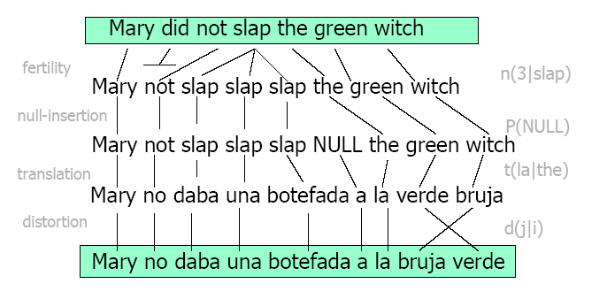
Statistical MT IBM Model (Word-based Model)
http://www.clsp.jhu.edu/ws03/preworkshop/lecture_yamada.pdf

Slide 21
Phrase-Based Statistical MT
Slide courtesy of Kevin Knight http://www.sims.berkeley.edu/courses/is290-2/f04/lectures/mt-lecture.ppt
Morgen
fliege
ich
nach Kanada
zur Konferenz
Tomorrow
I
will fly
to the conference
In Canada
Foreign input segmented in to phrases
“phrase” is any sequence of words
Each phrase is probabilistically translated into English
P(to the conference | zur Konferenz)
P(into the meeting | zur Konferenz)
Phrases are probabilistically re-ordered

Slide 22
Word Alignment Induced Phrases
Slide courtesy of Kevin Knight http://www.sims.berkeley.edu/courses/is290-2/f04/lectures/mt-lecture.ppt
Maria no dió una bofetada a la bruja verde
Mary
did
not
slap
the
green
witch
(Maria, Mary) (no, did not) (slap, dió una bofetada) (la, the) (bruja, witch) (verde, green)

Slide 23
Word Alignment Induced Phrases
Slide courtesy of Kevin Knight http://www.sims.berkeley.edu/courses/is290-2/f04/lectures/mt-lecture.ppt
Maria no dió una bofetada a la bruja verde
Mary
did
not
slap
the
green
witch
(Maria, Mary) (no, did not) (slap, dió una bofetada) (la, the) (bruja, witch) (verde, green)
(a la, the) (dió una bofetada a, slap the)

Slide 24
Word Alignment Induced Phrases
Slide courtesy of Kevin Knight http://www.sims.berkeley.edu/courses/is290-2/f04/lectures/mt-lecture.ppt
Maria no dió una bofetada a la bruja verde
Mary
did
not
slap
the
green
witch
(Maria, Mary) (no, did not) (slap, dió una bofetada) (la, the) (bruja, witch) (verde, green)
(a la, the) (dió una bofetada a, slap the)
(Maria no, Mary did not) (no dió una bofetada, did not slap), (dió una bofetada a la, slap the)
(bruja verde, green witch)

Slide 25
Word Alignment Induced Phrases
Slide courtesy of Kevin Knight http://www.sims.berkeley.edu/courses/is290-2/f04/lectures/mt-lecture.ppt
Maria no dió una bofetada a la bruja verde
Mary
did
not
slap
the
green
witch
(Maria, Mary) (no, did not) (slap, dió una bofetada) (la, the) (bruja, witch) (verde, green)
(a la, the) (dió una bofetada a, slap the)
(Maria no, Mary did not) (no dió una bofetada, did not slap), (dió una bofetada a la, slap the)
(bruja verde, green witch) (Maria no dió una bofetada, Mary did not slap)
(a la bruja verde, the green witch) …

Slide 26
Word Alignment Induced Phrases
Slide courtesy of Kevin Knight http://www.sims.berkeley.edu/courses/is290-2/f04/lectures/mt-lecture.ppt
Maria no dió una bofetada a la bruja verde
Mary
did
not
slap
the
green
witch
(Maria, Mary) (no, did not) (slap, dió una bofetada) (la, the) (bruja, witch) (verde, green)
(a la, the) (dió una bofetada a, slap the)
(Maria no, Mary did not) (no dió una bofetada, did not slap), (dió una bofetada a la, slap the)
(bruja verde, green witch) (Maria no dió una bofetada, Mary did not slap)
(a la bruja verde, the green witch) …
(Maria no dió una bofetada a la bruja verde, Mary did not slap the green witch)

Slide 27
Advantages of Phrase-Based SMT
Slide courtesy of Kevin Knight http://www.sims.berkeley.edu/courses/is290-2/f04/lectures/mt-lecture.ppt
Many-to-many mappings can handle non-compositional phrases
Local context is very useful for disambiguating
“Interest rate” → …
“Interest in” → …
The more data, the longer the learned phrases
Sometimes whole sentences

Slide 28
Road Map
Multilingual Challenges for MT
MT Approaches
MT Evaluation
Notes:
My work on palestinian, arabic mt and arabic hebrew mt
Highlight similarities and differences
A lot of similarities/differences not included

Slide 29
MT Evaluation
More art than science
Wide range of Metrics/Techniques
interface, …, scalability, …, faithfulness, ... space/time complexity, … etc.
Automatic vs. Human-based
Dumb Machines vs. Slow Humans

Slide 30
Human-based Evaluation Example Fidelity / Accuracy Criteria

Slide 31
Human-based Evaluation Example Fluency / Intelligibility Criteria

Slide 32
Semi-Automatic Evaluation Example Bleu Metric (Papineni et al 2001)
Bleu
BiLingual Evaluation Understudy
Modified n-gram precision with length penalty
Quick, inexpensive and language independent
Correlates highly with human evaluation
Compares MT output against several human translations to give a standardized score
Notes:
Unigram (accuracy)
2+grams (fluency)
Address biases latter in evals
Bleu is used with all 1 to 4-grams
with no context sensitivity. Confidence intervals are computed with a
sample size of 50 for 95\% confidence level. The Bleu specific version
number is v1.03.
The goal is to understand how much of the reference is
covered by which test sets and to measure the overlap among these test
sets. Bleu is used to calculate RMP with the gold standard used
as test and different combinations of the evaluated systems' output as
references. The RMP value is not a Bleu score, since no length
penalty is applied. The value is simply the geometric mean of the 1
to 4-gram precision (which itself is a sub-score in Bleu). The specific
variation of this metric used in this chapter is RMP-1,
which is the reference {\it unigram} precision.

Slide 33
Automatic Evaluation Example Bleu Metric
Test Sentence
(MT output)
colorless green ideas sleep furiously
Gold Standard References
(human translations)
all dull jade ideas sleep irately
drab emerald concepts sleep furiously
colorless immature thoughts nap angrily

Slide 34
Automatic Evaluation Example Bleu Metric
Test Sentence
colorless green ideas sleep furiously
Gold Standard References
all dull jade ideas sleep irately
drab emerald concepts sleep furiously
colorless immature thoughts nap angrily
Unigram precision = 4/5

Slide 35
Automatic Evaluation Example Bleu Metric
Test Sentence
colorless green ideas sleep furiously
colorless green ideas sleep furiously
colorless green ideas sleep furiously
colorless green ideas sleep furiously
Gold Standard References
all dull jade ideas sleep irately
drab emerald concepts sleep furiously
colorless immature thoughts nap angrily
Unigram precision = 4 / 5 = 0.8
Bigram precision = 2 / 4 = 0.5
Bleu Score = (a₁ a₂ …a_{n})^{1/n}
= (0.8 ╳ 0.5)^{½} = 0.6325 ➔ 63.25

Slide 36
Summary
Multilingual Challenges for MT:
Different writing systems, morphology, segmentation, word order;
Need parallel corpus, dictionaries, NLP tools
MT Approaches: statistical v rule-based
Gisting: word-for-word;
Transfer: source-to-target phrase mapping;
Interlingua: map to/from “semantic representation”
MT Evaluation: Accuracy, Fluency
IBM BLEU method:
count overlaps with Reference (human) translations
Notes:
My work on palestinian, arabic mt and arabic hebrew mt
Highlight similarities and differences
A lot of similarities/differences not included

